Slide 1
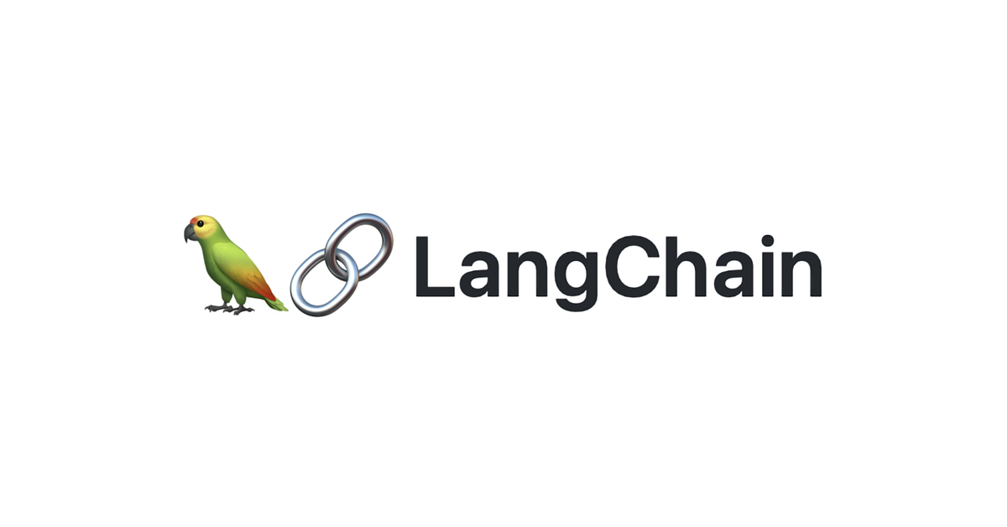
RAG from scratch: Generation
Lance Martin
Software Engineer, LangChain
@RLanceMartin
Notes:
This is the fourth video in our series on RAG. The aim of this series is to build up an understanding of RAG from scratch, starting with the basics of indexing, retrieval, and generation. This video focuses on generation, covering the process of RAG prompt construction and passing the prompt to an LLM for answer generation. See this notebook for code: https://github.com/langchain-ai/rag-from-scratch/blob/main/rag_from_scratch_1_to_4.ipynb

Slide 2
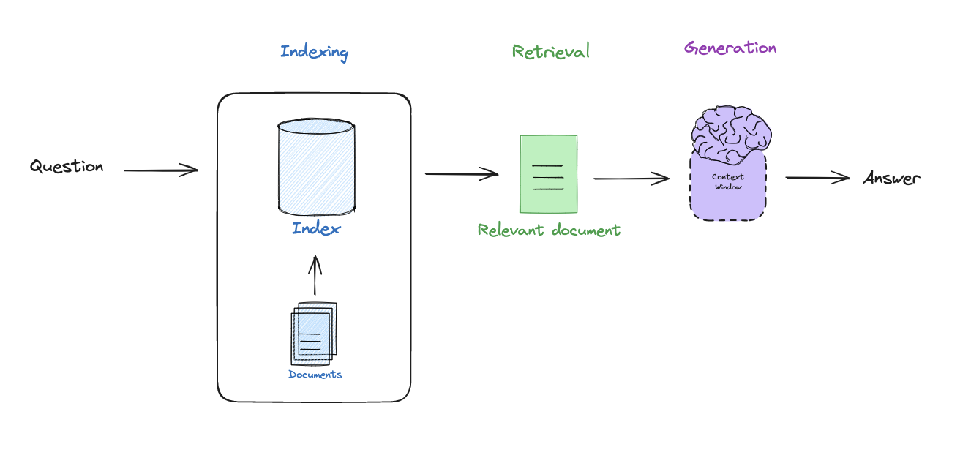
RAG motivation
Notes:
In the past videos, we walked through the basic components of RAG: (1) indexing (make external data retrievable), (2) retrieval (fetch external data that is relevant to a query that we want the LLM to reason about. Now we will cover (3) generation pass this to an LLM to generate an answer.
Loom:
https://www.loom.com/share/863e9f5153324ea6b5af4d449624167e

Slide 3
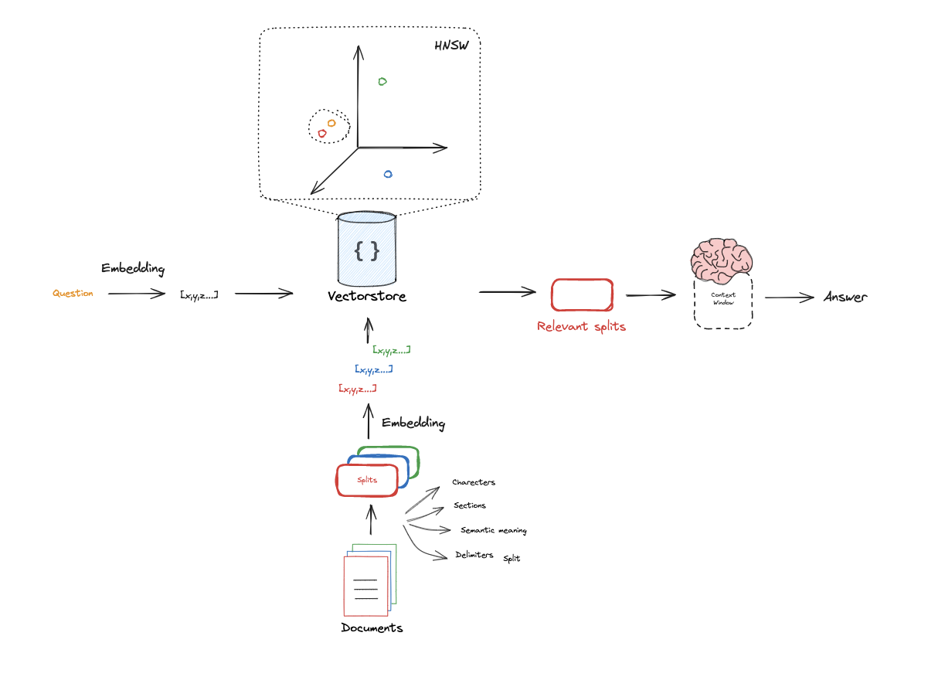
Adding docs to context window
https://python.langchain.com/docs/use_cases/question_answering/
Notes:
In particular, this involves retrieving documents as we saw before, but then passing them into the LLM context window so that the LLM can reason about them.

Slide 4
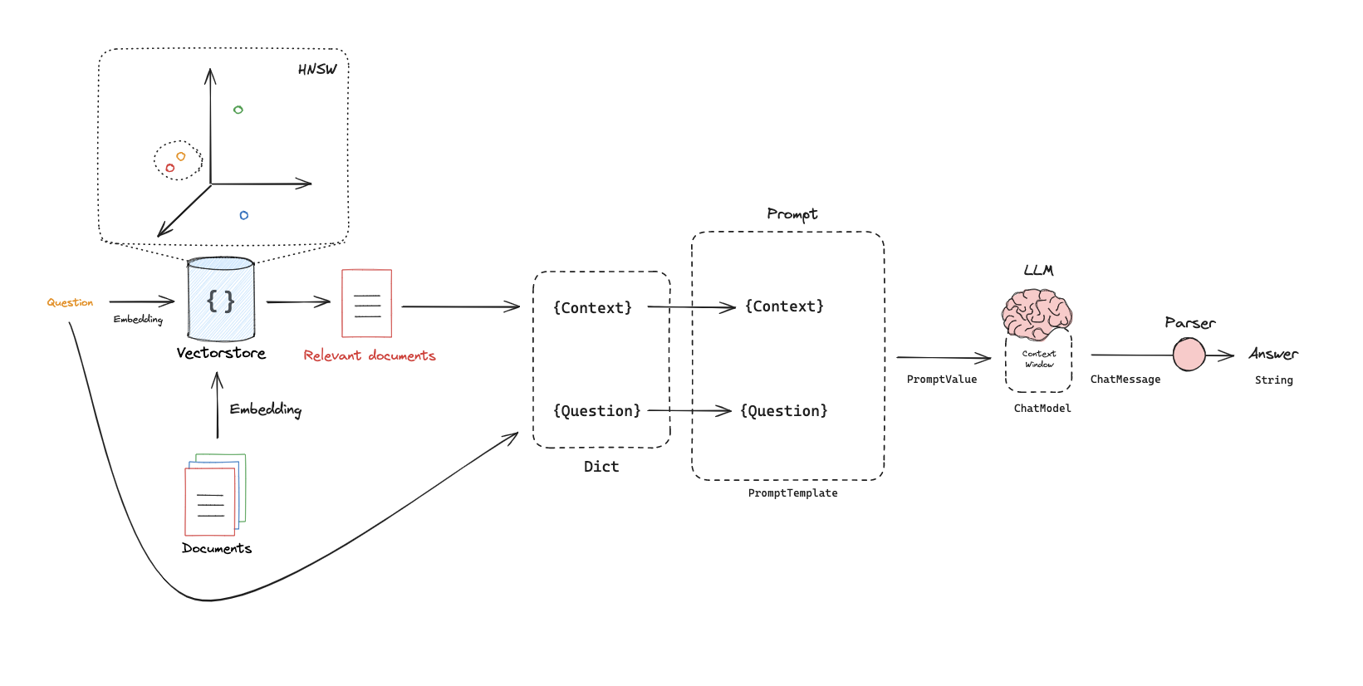
Connecting retrieval with LLMs via prompt
https://python.langchain.com/docs/expression_language/get_started
https://smith.langchain.com/hub/rlm/rag-prompt?organizationId=1fa8b1f4-fcb9-4072-9aa9-983e35ad61b8
Notes:
This uses the the idea of a prompt, which is a template that includes placeholders that we can popular with our particular retrieved docs and question.
There are specific prompts that we can use for RAG.

Slide 5
Code walk-through

